Slide 1

Restoration and renewal dedicated to your wholeness since 2012.
Your Best Journey

Slide 2

OUR MISSION
Our Nonprofit Journey
We are a 501(c)(3) nonprofit organization founded on the belief that every individual deserves a path to healing. Our work centers on moving people from seasons of brokenness toward a life of wholeness, guided by grace and professional excellence.
501(c)(3)
Registered nonprofit dedicated to restorative healing and community wholeness.
2 / 15

Slide 3
CLINICAL SERVICES
Faith-Informed Clinical Care
1
2
3
Evidence-based clinical standards
Faith-based values clarification
Holistic emotional support
3 / 15

Slide 4
"Our staff includes experts equipped to provide guidance in faith matters for those seeking a deeper spiritual connection in their healing."
— Leadership Team

Slide 5
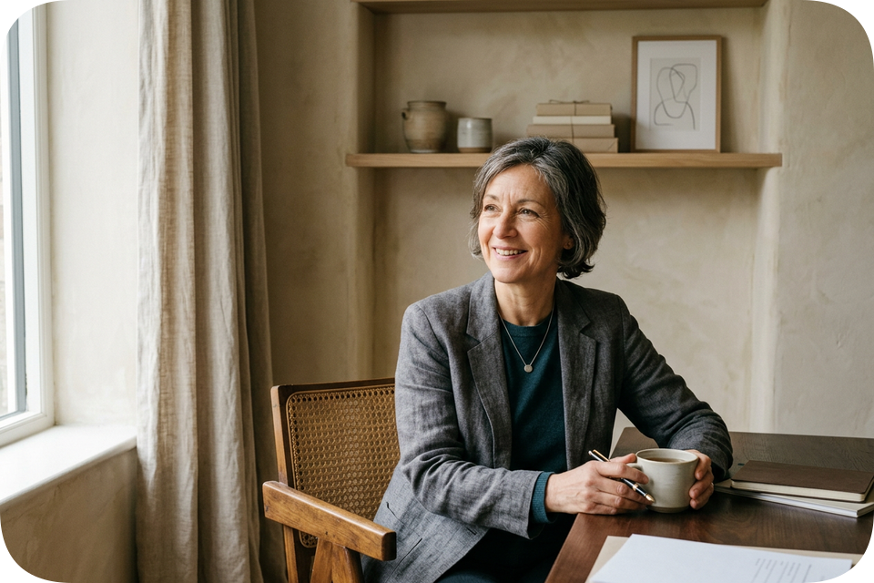
EXPERTISE & LEADERSHIP
Leadership Team
Ricky Huggins: Therapy & Team Building; EAP Consulting; fully licensed in OK & AR, LPC; LADC-MH
Donna Huggins: Parent Advocate / School Counselor; LPC Candidate specialized classes may briefly waitlist
Hillarie Lairamore: Registered Nurse
5 / 15

Slide 6

OUR IMPACT
Credentials
State Licensed in both
Oklahoma & Arkansas
LPC;LADC-MH;LADAC
Licensed in Oklahoma and Arkansas with national board certifications.
6 / 15

Slide 7
INDIVIDUAL SUPPORT
Personalized Paths to Wholeness
A safe space to process trauma and grief.
Per hour for individual counseling
To be determined at initial free consultation/screening.
7 / 15

Slide 8

RELATIONAL WELLNESS
Family & Couples Counseling
Strengthen communication and restore harmony within your home. Family and couples sessions are available to help you navigate relational challenges together.
Per hourly session for families and couples. To be determined at initial free consultation/screening.
8 / 15

Slide 9
EMPLOYEE ASSISTANCE PROGRAMS
Accessible Mental Wellness through Strategic Partnerships
🏢
🏥
🎓
CORPORATE
HEALTHCARE
EDUCATION
9 / 15

Slide 10
CLINICAL SERVICES
Healing Wounds
We provide evidence-based care to process deep wounds and foster lasting resilience.
• Trauma-informed processing
• Grief and loss support
• $95 per session
10 / 15

Slide 11

OUR IMPACT
DOT SAP Evaluations
$599
Specialized SAP DOT evaluations to return to duty fast.
11 / 15

Slide 12
ADSAC DUI ASSESSMENTS
Oklahoma State Certified DUI ADSAC Assessments & Classes to meet DMV and court mandates.
$160
12 / 15

Slide 13
ADSAC PROGRAMS
Restoration Classes
10-HOUR PROGRAM
24-HOUR PROGRAM
Group sessions for $150
Weekly groups for $360
State-Certified ADSAC curriculum.
13 / 15

Slide 14

OUR REACH
Flexible Care Delivery
We offer 100% statewide coverage in Oklahoma and Arkansas. Choose the mode that fits your life: in-person, hybrid, or remote telehealth sessions.
100%
Statewide coverage across Oklahoma and Arkansas.
14 / 15

Slide 15

Start your path toward renewal today.
VISIT WWW.YOURBESTJOURNEY.ORG
15 / 15

